Slide 1

COMPUTER NETWORKS
Sivaraman Eswaran Ph.D.
Department of Computer Science and Engineering

Slide 2

COMPUTER NETWORKS
Application Layer
Sivaraman Eswaran Ph.D.
Department of Computer Science and Engineering

Slide 3




COMPUTER NETWORKS
Unit – 2 Application Layer
2.1 Principles of Network Applications
2.2 Web, HTTP and HTTPS
2.3 The Domain Name System
2.4 P2P Applications
2.5 Socket Programming with TCP & UDP
2.6 Other Application Layer Protocols

Slide 4








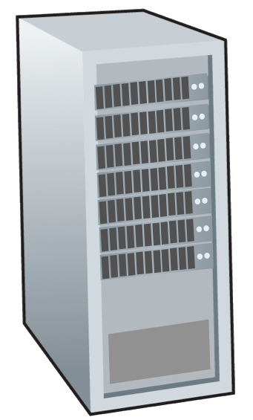







COMPUTER NETWORKS
Peer-to-peer (P2P) architecture
no always-on server
arbitrary end systems directly communicate
peers request service from other peers, provide service in return to other peers
self scalability – new peers bring new service capacity, and new service demands
peers are intermittently connected and change IP addresses
complex management
examples: P2P file sharing (BitTorrent), media streaming (Spotify), VoIP (Skype)
mobile network
national or global ISP
local or regional ISP
home network
content
provider
network
datacenter
network
enterprise
network

Slide 5

COMPUTER NETWORKS
File distribution: client-server vs P2P
Q: how much time to distribute file (size F) from one server to N peers?
peer upload/download capacity is limited resource
The distribution time is the time it takes to get a copy of the file to all N peers.
u_{s}: server upload capacity
d_{i}: peer i download capacity
file, size F
u₁
d₁
u₂
u_{s}
d₂
server
d_{i}
u_{N}
network (with abundant
bandwidth)
u_{i}
d_{N}
u_{i}: peer i upload capacity

Slide 6
COMPUTER NETWORKS
File distribution time: client-server
server transmission: must sequentially send (upload) N file copies:
time to send one copy: F/u_{s}
time to send N copies: NF/u_{s}
F
u_{s}
d_{i}
network
client: each client must download file copy
d_{min} = min client download rate
min client download time: F/d_{min}
u_{i}
time to distribute F
to N clients using
client-server approach
D_{c-s} > max{NF/u_{s,},F/d_{min}}
increases linearly in N

Slide 7
COMPUTER NETWORKS
File distribution time: P2P
server transmission: must upload at least one copy:
time to send one copy: F/u_{s}
F
u_{s}
d_{i}
client: each client must download file copy
min client download time: F/d_{min}
network
u_{i}
Eqtn - provides a lower bound for the minimum distribution time for the P2P
architecture.
clients: as aggregate must download NF bits
max upload rate (limiting max download rate) is u_{s} + Σu_{i}
Total upload capacity of the system as a whole
time to distribute F
to N clients using
P2P approach
D_{P2P} > max{F/u_{s},F/d_{min},NF/(u_{s} + Σu_{i})}
increases linearly in N …
… but so does this, as each peer brings service capacity

Slide 8
COMPUTER NETWORKS
Client-server vs. P2P: example
Client (all peers) upload rate = u, F/u = 1 hour, u_{s} = 10u, d_{min} ≥ u_{s}
A peer can transmit the entire file in one hour.
The server transmission rate is 10 times the peer upload rate.
Peer download rates are set large enough so as not to have an effect.

Slide 9


COMPUTER NETWORKS
P2P file distribution: BitTorrent
file divided into 256Kb chunks
peers in torrent send/receive file chunks
tracker: tracks peers
participating in torrent
torrent: group of peers exchanging chunks of a file
Alice arrives …
… obtains list
of peers from tracker
… and begins exchanging
file chunks with peers in torrent

Slide 10


COMPUTER NETWORKS
P2P file distribution: BitTorrent
peer joining torrent:
has no chunks, but will accumulate them over time from other peers
registers with tracker to get list of peers, connects to subset of peers (“neighbors”)
while downloading, peer uploads chunks to other peers
peer may change peers with whom it exchanges chunks
churn: peers may come and go
once peer has entire file, it may (selfishly) leave or (altruistically) remain in torrent

Slide 11
COMPUTER NETWORKS
BitTorrent: requesting, sending file chunks
Requesting chunks:
at any given time, different peers have different subsets of file chunks
periodically, Alice asks each peer for list of chunks that they have
Alice requests missing chunks from peers, rarest first
Sending chunks: tit-for-tat
Alice sends chunks to those four peers currently sending her chunks at highest rate
other peers are choked by Alice (do not receive chunks from her)
re-evaluate top 4 every 10 secs
every 30 secs: randomly select another peer, starts sending chunks
“optimistically unchoke” this peer
newly chosen peer may join top 4

Slide 12

COMPUTER NETWORKS
BitTorrent: tit-for-tat
(1) Alice “optimistically unchokes” Bob
(2) Alice becomes one of Bob’s top-four providers; Bob reciprocates
(3) Bob becomes one of Alice’s top-four providers
Pieces (mini-chunks), pipelining, random first selection, endgame mode, and anti-snubbing
higher upload rate: find better trading partners, get file faster !

Slide 13


COMPUTER NETWORKS
Suggested Readings
BitTorrent (BTT) White Paper – https://www.bittorrent.com/btt/btt-docs/BitTorrent_(BTT)_White_Paper_v0.8.7_Feb_2019.pdf
Peer-to-peer networking with BitTorrent – http://web.cs.ucla.edu/classes/cs217/05BitTorrent.pdf
Torrents Explained: How BitTorrent Works – https://youtu.be/urzQeD7ftbI

Slide 14
THANK YOU
Sivaraman Eswaran Ph.D.
Department of Computer Science and Engineering
sivaramane@pes.edu
+91 80 6666 3333 Extn 834

